Slide 1
AWS SAP - Datastore

Slide 2
Types of Data stores
Persistent – RDS, Glacier
Transient – SQS, SNS
Ephemeral – EC2 Instance store, Memcached

Slide 3
IOPS vs Throughput
IOPS - how fast you can read and write to a device
Throughput – how much data can be moved at a time

Slide 4
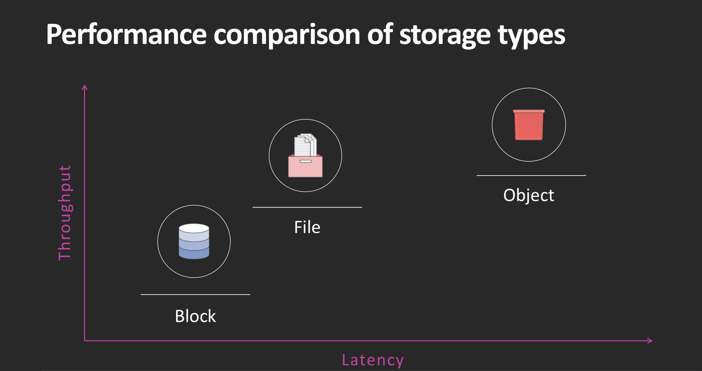

Slide 5
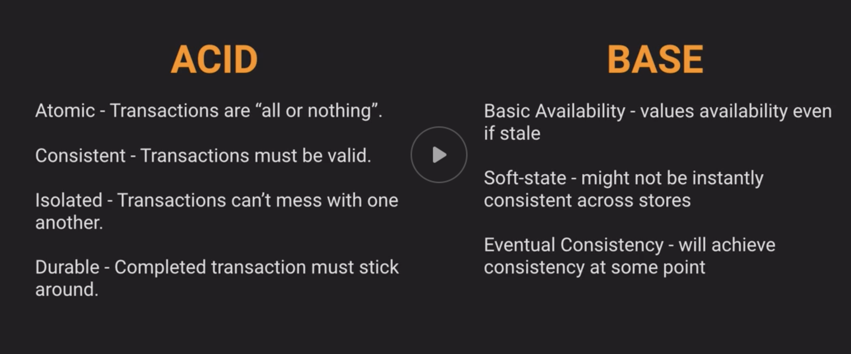
Consistency models

Slide 6
Consistency model
BASE - S3, Dynamo. It is still consistent, just works parallelly
ACID – RDS. Is consistent at all times but does not scale very well

Slide 7
S3
Max object size: 5TB
Largest object in single put: 5GB
Multi-part upload recommended for files > 100MB
S3 filepath is actually a “KEY”

Slide 8
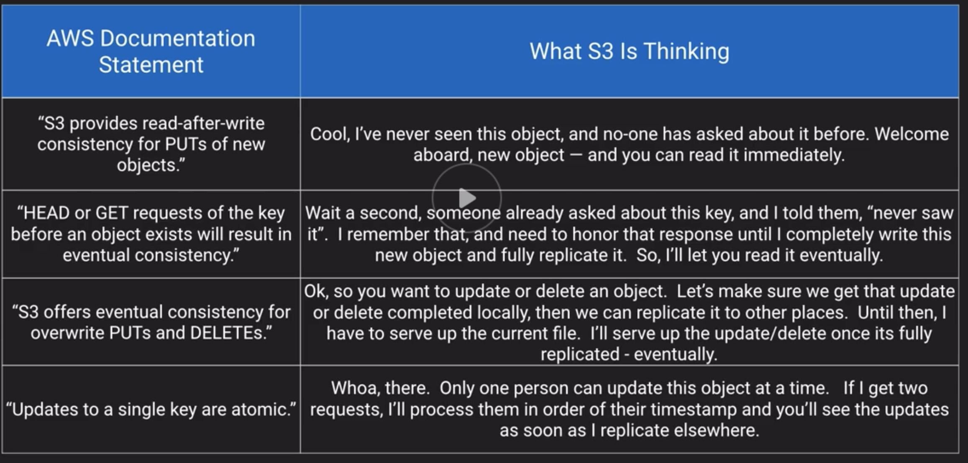
S3 request processing logic

Slide 9
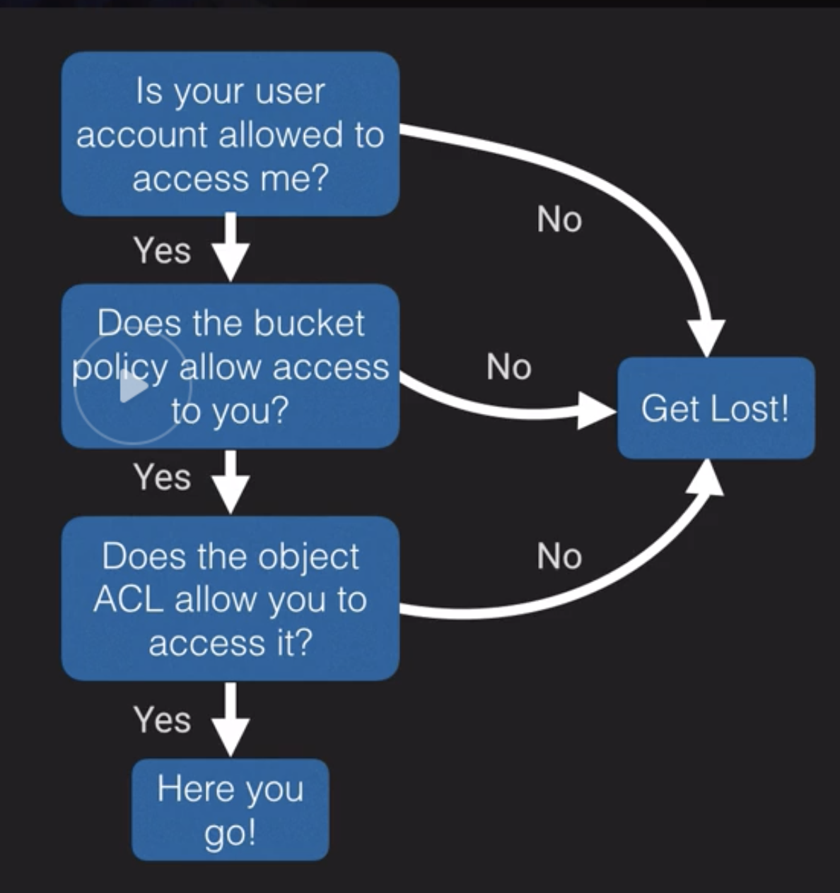
S3 security
ACL/Bucket policy
IAM user
MFA delete – safeguard
Accidental deletion

Slide 10
S3 versioning and data protection
Old versions count as billable size
Old versions can be deleted using lifecycle policies
Data protection –
MFA delete
Cross region replication – for Security, compliance, latency

Slide 11
S3 lifecycle policies
By tags
By current or previous version

Slide 12
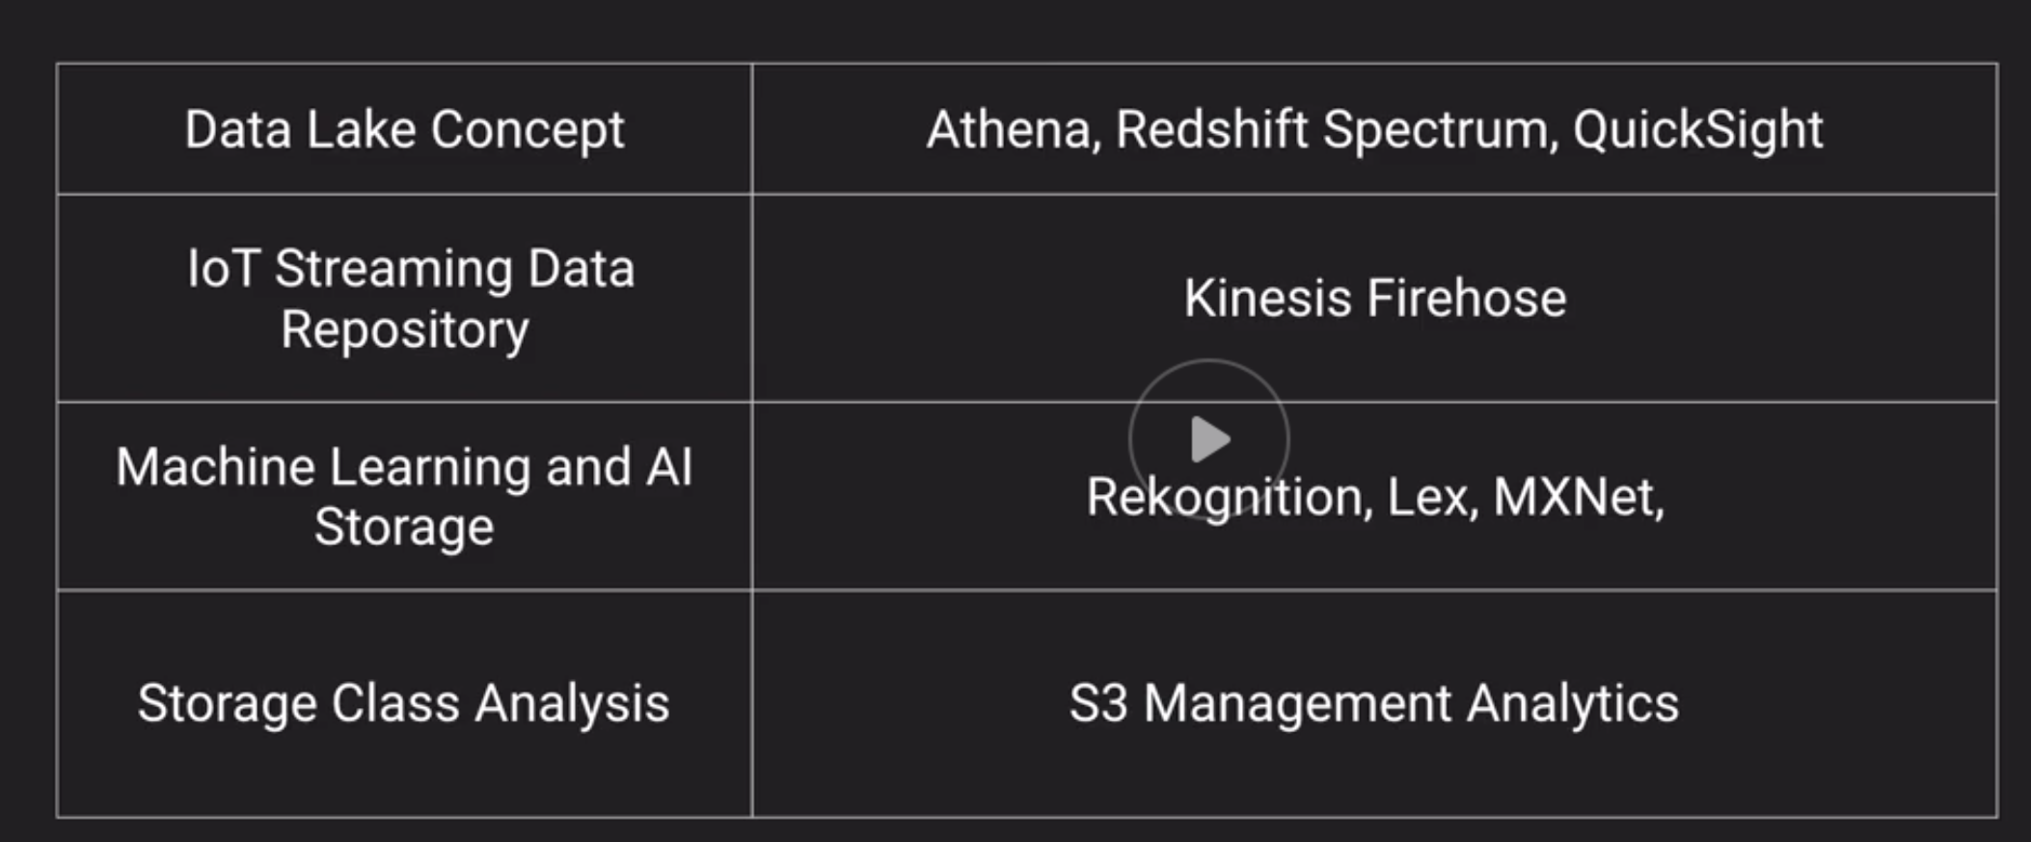
S3 analytics

Slide 13
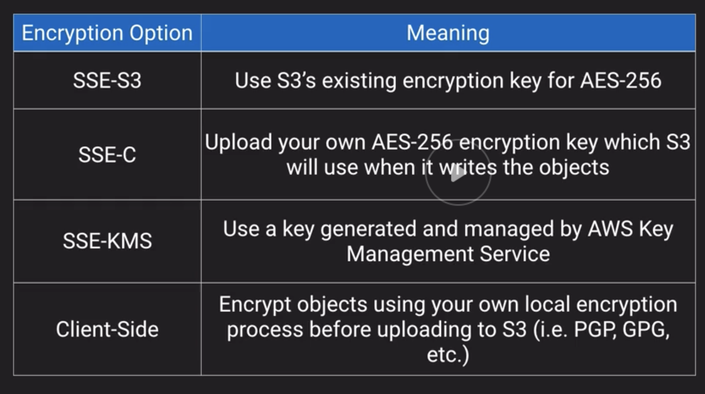
S3 encryption

Slide 14
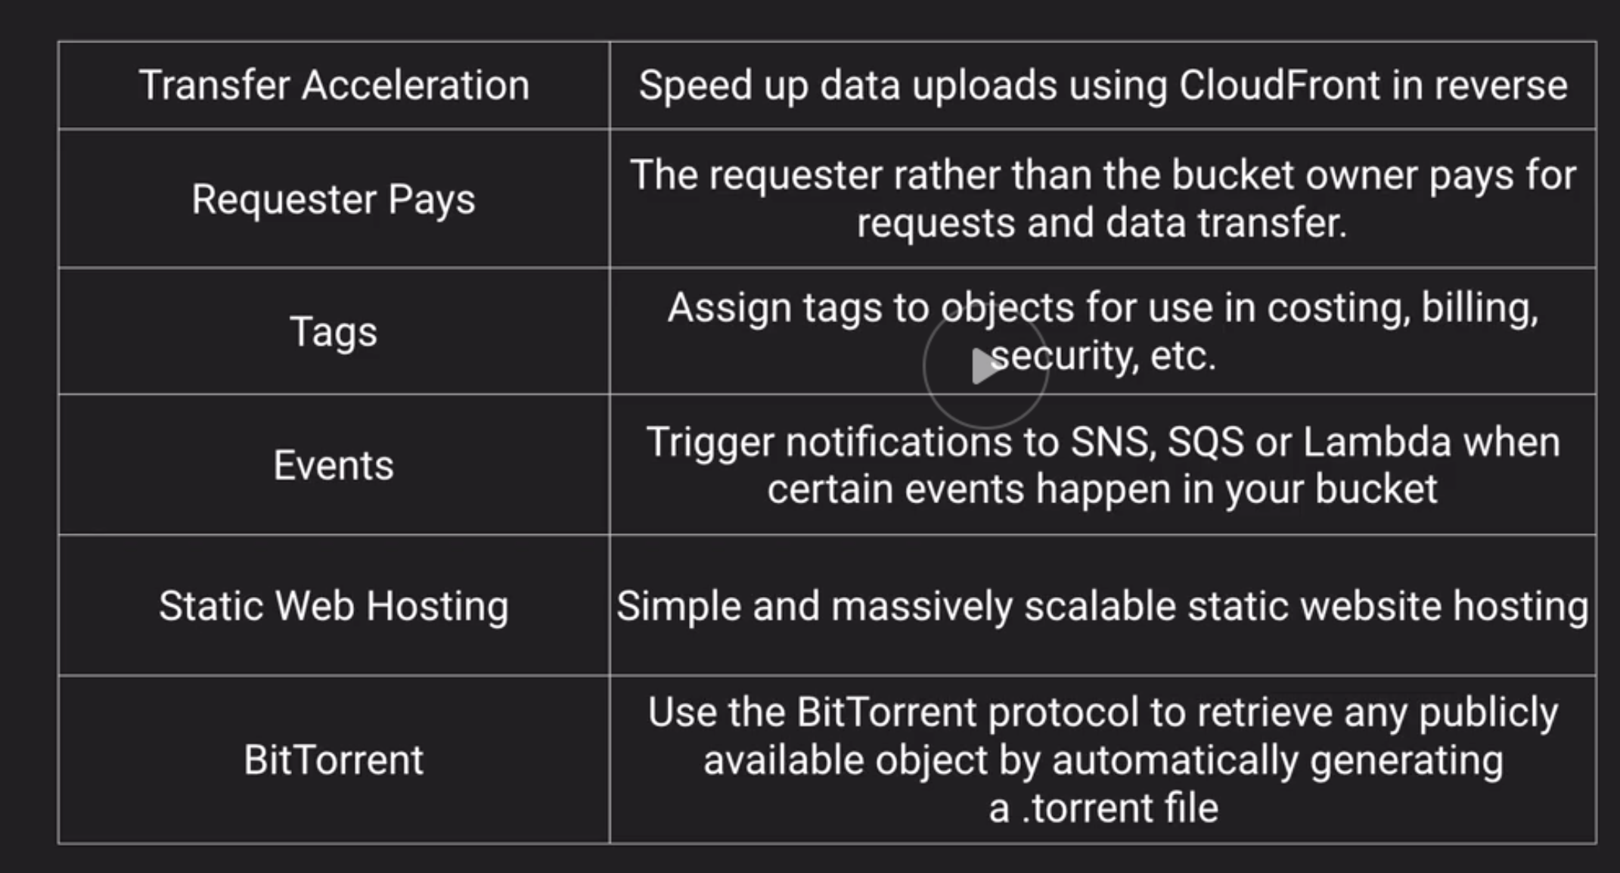
S3 features

Slide 15
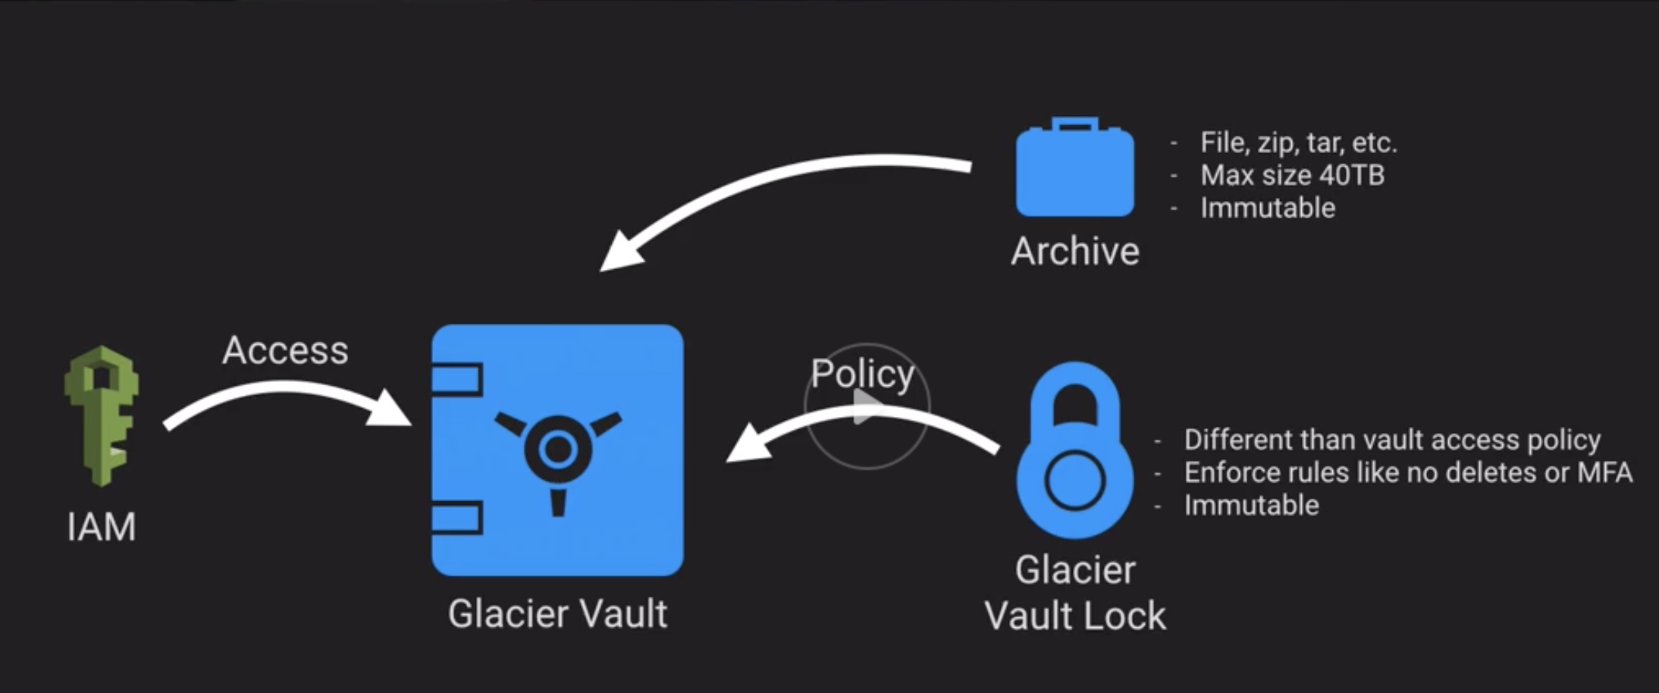
Glacier
Used by Virtual tape storage GW
Not as fast as S3 – even though expedited retrieval is now possible
Vault locks – 24 period for confirmation

Slide 16
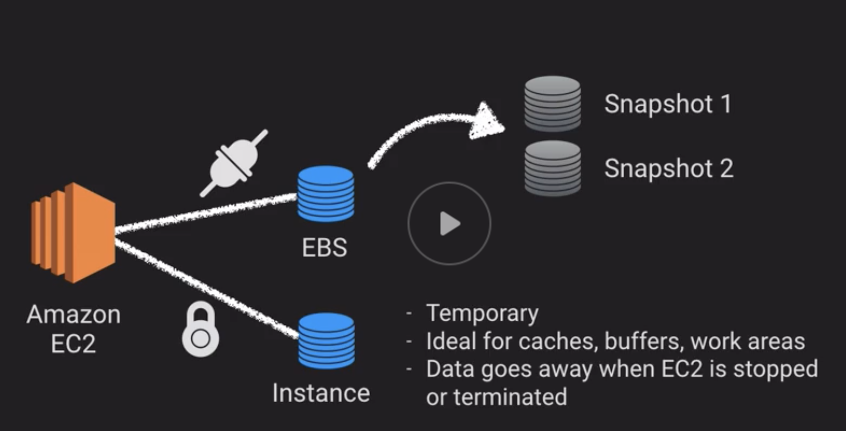
EBS
Tied to single AZ

Slide 17
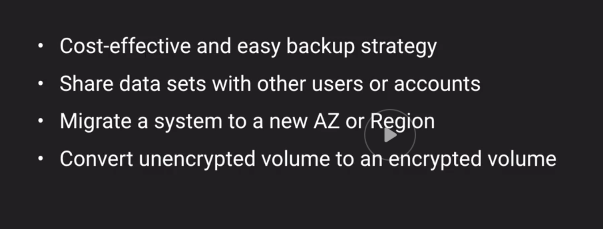
Snapshots
Snapshots only copy the change, not the entire volume. Only first snapshot has everything.
Even if snapshot 1 is deleted you can still retrieve snapshots

Slide 18
Snapshots

